Slide 1
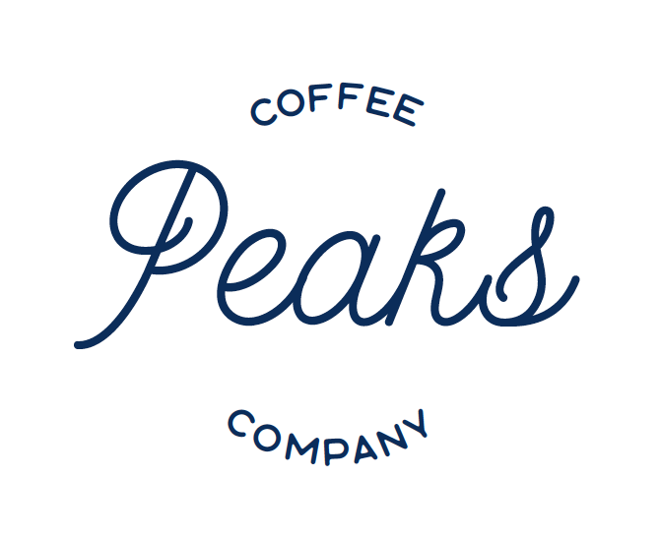

Kelsey Bender ¹
(315)-708-2862
1200 E Genesee St
Syracuse, NY 13210
Notes:
Our group chose Peaks Coffee because we were interested in the food industry, and Peaks Coffee piqued our interest.

Slide 2


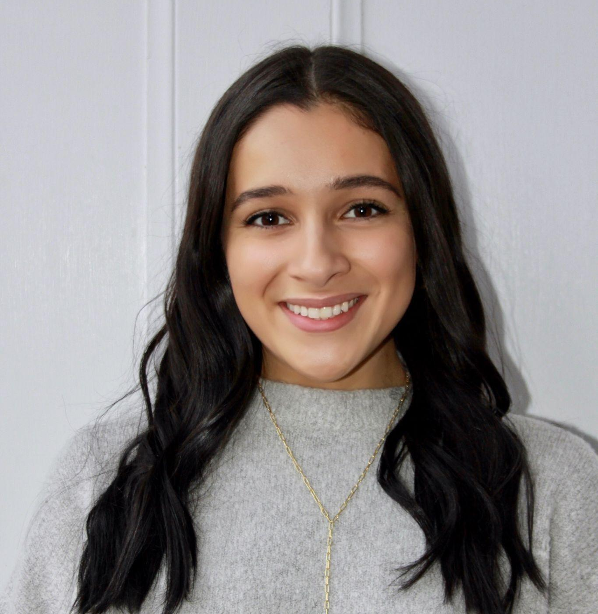
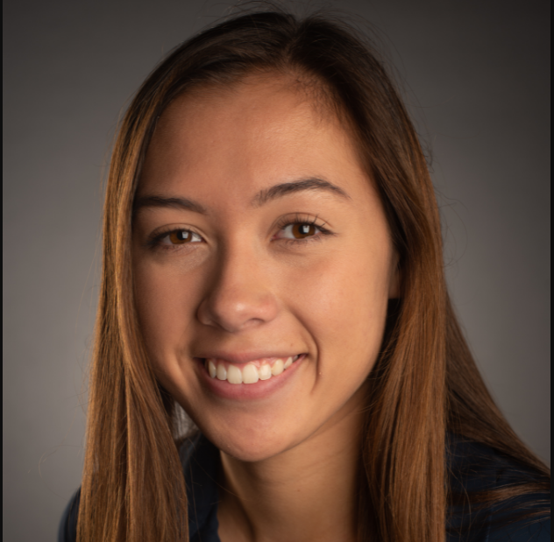
The Team
Zachary Goldstein
Major: IM&T
Concentration: Information Security Management
William Chen
Major: IM&T
Concentration: Information Security Management
Cristina Aillon
Major: IM&T
Concentration: Data Analytics
Minor: Art History
Taylor Carlson
Major: IM&T
Concentration: Information Security Management and Data Analytics
Notes:
All of us are in the same major (Information management and technology). Everyone but Cristina has a concentration in Information Security Management. Cristina and Taylor have a concentration in Data Analytics.

Slide 3
AGENDA
Research Methods
Industry Overview
IBISWorld Reports
Overview of Peaks Coffee
Interviews and Site Visits
SWOT analysis
Major Risks
Recommendations
Lessons Learned and Insights
References

Slide 4
Research Methods
Archival Information Searches
IBISWorld report 72221B- Coffee shops & Snack shops in US
Peaks Coffee Website- https://www.peakscoffeeco.com/
Social Media (Facebook and Instagram)
Google
“Peaks Coffee”
Observations
Non-recorded interviews
Owner
Employees (Barista)
Notes:
We used the IBISWorld reports for market data to learn a little bit more about the coffee industry. We also went into Peaks when they were open and observed the employees and customers. We tracked how the interactions were among employees themselves and the customers. A lot of company information was found through their company website and the interviews we did with the owner (which we, unfortunately, forgot to record but took notes). The remaining information was found through Google. We used Google to research most of the information we needed, which led us to multiple sources of information (we determined which ones were reliable). The key search term we used was “Peaks Coffee,” which led to a plethora of information such as their social media, reviews, and news articles. We also used social media (their Facebook and Instagram) to look at details we may have missed on other websites.

Slide 5
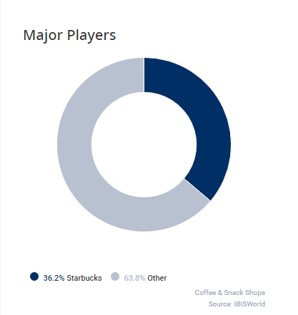
Coffee Shops and Cafes
Revenue: $47.1 Billion ³
7.2% decline in 2020 ³
Expected to recover to $51.6 billion (revenue) by 2026
Profit: $2.1 Billion ³
Profit margin: 4.5%
63,630 businesses with over 760,000 employees ³
Industry is comprised of coffees, teas, and snacks ³
36.2% Starbucks
Notes:
Coffee shops are currently in high demand and are expected to grow substantially within the next five years. According to the IBIS World Reports, coffee shops had a revenue of about $47.1 billion. However, when the pandemic hit in 2020, there was a 7.2% decline in revenue. Despite the setback, it’s on track to recover to $51.6 billion in revenue by 2026. Even though the revenue is $47.1 billion, coffee shops have low-profit margins at 4.5%, making about $2.1 billion. There are about 63,630 businesses with over 760,000 employees (including major coffee shops). The industry is comprised of coffees, teas, and snacks. Starbucks takes about ⅓ or 36.2% of the industry. Starbucks has a massive stake in this industry and is one of the most well-known companies. Despite this, Peaks Coffee isn’t dramatically affected by it.

Slide 6
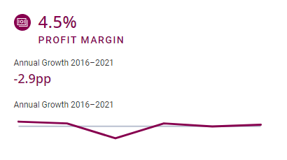
Coffee Shops and Cafes (Continued)
Traditional risks may include:
Injury due to specialty equipment ²
Subtle hazards such as change in floor level ⁴
Technology risks such as point of sale system failure
Consumer risks ³
Non-Traditional Risks:
Pandemic ⁵
Notes:
This industry is comprised of operators who prepare or serve specialty products, including coffees, teas, specialty beverages, snacks, pastries, or meals. Purchased items may be consumed on-site or taken to go or delivered. Injury due to specialty equipment includes burns from espresso machines and cooking equipment (knives or other sharp objects). Subtle hazards such as floor plans, steps, changes in floor level in kitchen areas, serving areas, and seating areas. Consumer risks such as low spending rates can lead to low revenue growth. The pandemic caused the inability to serve customers due to temporary closure, lack of employees, and lack of customers. Competition is expected to intensify, but there’s also a large demand for coffee shops (more so than other segments of the foodservice industry)

Slide 7
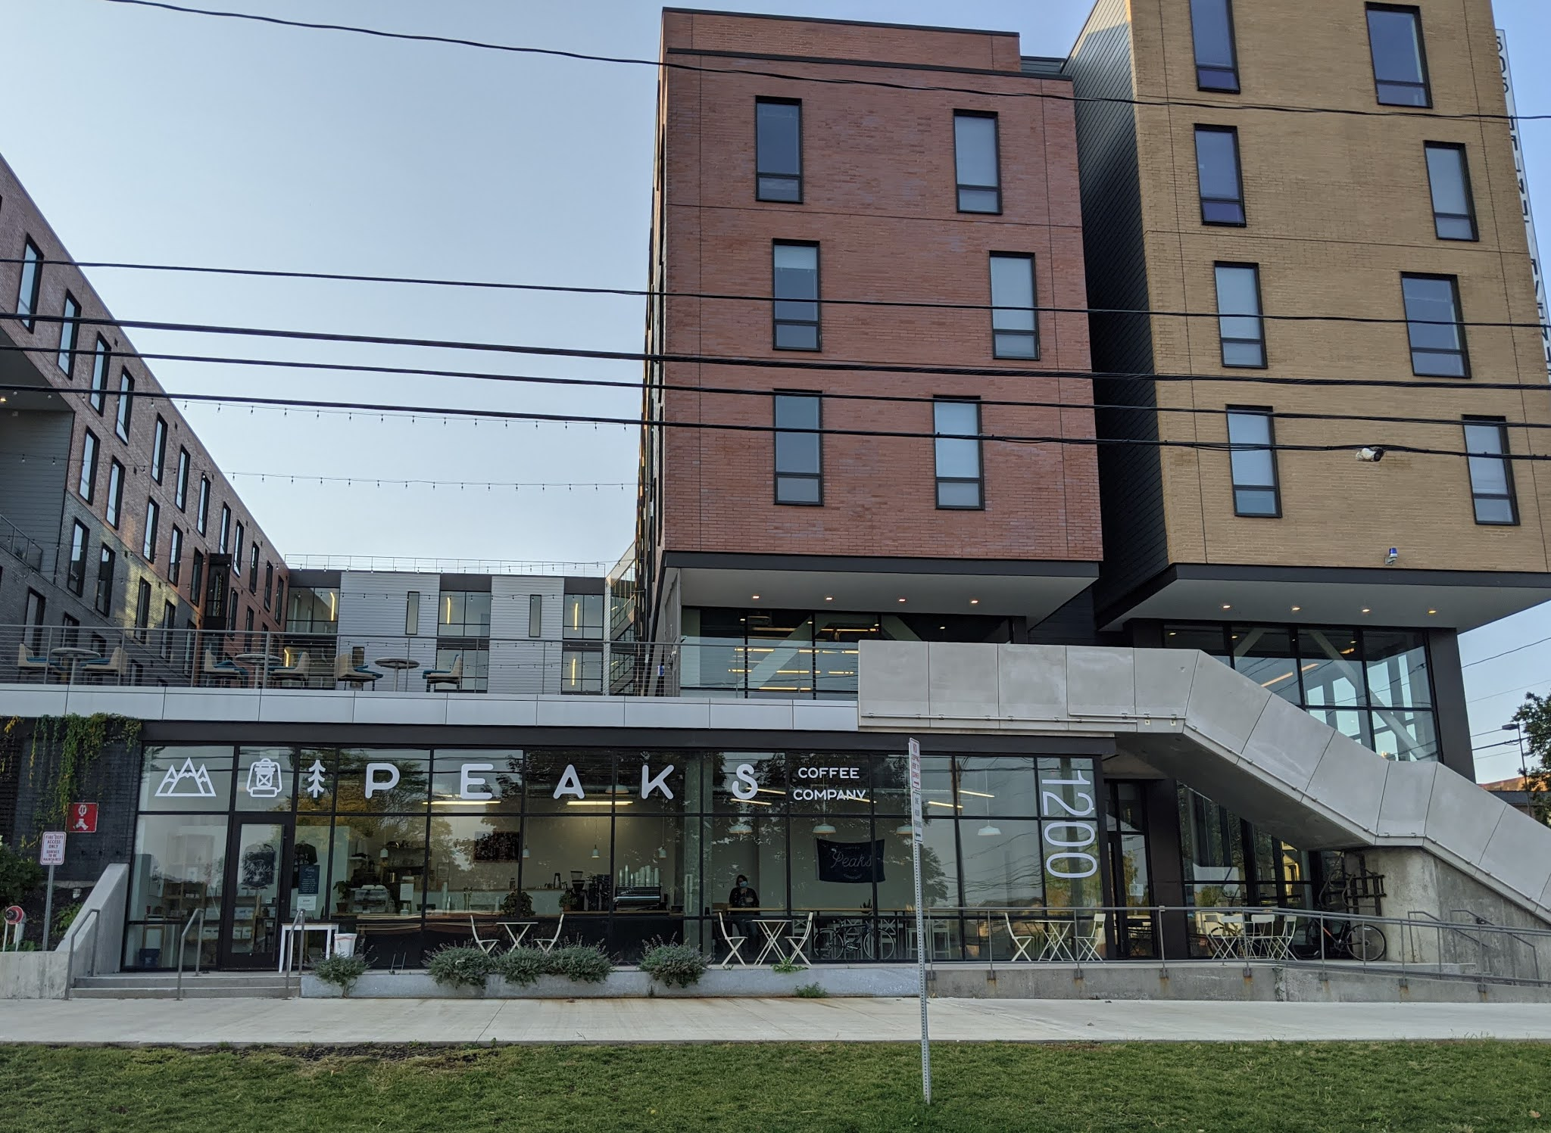
Peaks Coffee Company Overview
Peaks Coffee started in 2014 ⁶
Slogan: "Life is about enjoying the peaks and enduring the valleys" ⁷
Sustainably sourced coffees and direct trades in many countries like Colombia ⁸
Retail, wholesale, and online store
Eight partners throughout the states (Seven in NY, one in MA) ⁹
Sells coffee, tea, and food from The Sweet Praxis ¹⁰
Roastery is located in Cazenovia, Cafe is located in 505 on Walnut ¹¹
6 employees ¹
No risk management strategies
Notes:
Peaks coffee started in 2014 but opened the brick-and-mortar space in 2015 in Cazenovia. Their slogan is about mental health and raising awareness about mental health issues. Peaks coffee is a separate LLC from its roastery. The roastery is responsible for the wholesale side, and the coffee shop is the retail side. The owners of Peaks are also very young (26 years old) and didn’t go to college. They started Peaks coffee using their savings account and eventually grew into the Peaks coffee that is known now. Before their current location, they operated in Nelson Corners, which is just outside of Cazenovia, for three years. They also sell food from The Sweet Praxis and another bakery. They buy the food at wholesale prices and sell it marked up slightly higher to make some profit. They also make their own food items using bakery items.

Slide 8
Interviews and Site Visits
October 29, 2021
October 29, 2021
November 1, 2021
November 11, 2021
Participant Observation
Employee Interview (Barista)
Owner Interview
Site Visit
Team ate at Peaks (30 minutes - Taylor and Cristina)
45 minutes - Taylor and Cristina
2 hours - William, Zach, Taylor
30 minutes - Everyone
Notes:
Our first site visit was on October 29. Taylor and Cristina went on that date to observe the interactions and how the business operates and interviewed the employees to receive initial feedback. On November 1, everyone but Cristina interviewed the owner and asked 99% of the questions we needed to know the answer to. It was a straightforward interview, but we also plan to go back for another observation and maybe do another interview with the owner and employees. We want to see if the owner told us anything different from what the employees said. We feel that we have sufficient information about the risks and how Peaks runs its business.

Slide 9
SWOT Analysis
Strengths
Weaknesses
Opportunities
Threats
Strong community
Years of experience
High growth potential
Good work culture
Competitors
Lack of risk management awareness
Low profit margins
Low brand awareness
Team effort
Growth of the roastery
Expansion (second shop)
Increasing orders at roastery
Customer relationship
Brand awareness
COVID-19
Competitors
“Bad” (behaving) customers
Lack of risk management practice
Low profit margins
Increased supplier costs
Notes:
This SWOT analysis is based on our observations and what we were told. There are no particular strengths, weaknesses, opportunities, or threats. The owners of peaks coffee have many years of experience and have built a strong community along the way. Some of their weaknesses are the competitors (which is also a threat), low-profit margins, and the owners having a lack of risk management. All risks are tackled on the spot, and there are no plans/steps for employees to follow. There are tons of opportunities for Peaks to grow. According to IBIS, coffee shops are in demand and are expected to be one of the largest growing industries within the next five years. Peaks Coffee has plans on opening a second location soon (and the roastery). Additionally, they already have a strong customer base, and if they can reach out to more people through social media, that customer base will continue to grow. Some of the threats they face are COVID-19, competition, and “bad” customers. Bad customers are those that cause some sort of problem.

Slide 10
Major Risks (In order of importance)
Risk | Risk Measurement | Risk Management
Machines breaking down | Occupational Safety and Health Administration(OSHA) | Backup machines in roastery
Supply Chain/Environmental changes | Quality of coffee | Secure multiple bean shipments from different areas
Employees | Number of employees Employee evaluation | Performance evaluation Training
Food waste | Tracking and monitoring inventory | Limit menu items Produce less food/make food as needed
Notes:
There were several risks that Kelsey mentioned during our interview with her. We created this chart ourselves. There was no prioritization of one risk over the other, so there is no particular order in the chart. Some of these risks are machinery, supply chain/environmental changes, food waste, and employees. They recently had a machine malfunction, and luckily, they were friends with another roastery in Rochester, which let Peaks fulfill orders there. They import the coffee beans from other countries, and there’s no way to check the beans before having them sent to them, so if the beans are bad, so is the coffee. During the beginning stages of developing Peaks, they made an excessive amount of food that they threw out every day (but they learned and now make less food to minimize food waste). The owners of Peaks are wary of the lack of employees and the potentially harmful actions of those employees.

Slide 11
Major Risks (Continued)
Risk | Risk Measurement | Risk Management
Seasonality of business (i.e. students going home for breaks) | Tracking revenue | Building a strong community
Competing coffee shops | Tracking revenue | Building a strong sense of community among patrons
“Bad” (behaving) customers | Behavior Staff complaints | Security officers/police Building manager
Cyber Risks | Financial impacts Data breach | Cyber risk management software Encryption
Notes:
Cyber risks weren’t mentioned during the interview, but we thought it was one of their risks. The owners said they started taking more online orders when COVID happened, which means customers input their names, phone numbers, and credit card information when checking out. If this information gets out, then it could be one of their most severe risks. Most customers are students, but when students go home for break, that becomes a risk. As mentioned earlier, Peaks Coffee has a strong community base, and they come back when the students leave. Another risk is bad (behaving customers). These are customers that cause some sort of problem, such as threatening employees or throwing a tantrum. Another risk is competing coffee shops because there are several shops in the surrounding area.

Slide 12
Recommendations
Mitigate future risks - Create an emergency response/disaster recovery plan (for employees)
Opportunities (for growth and to reduce competition) - Expand when possible
Funds available through savings and profits
Expansions already in the talks
Coffee shops in demand
Reduce labor costs - Automation (new technology)
Minimize effects of competition - Create loyalty program
Customer awareness - Partnerships with other businesses
Notes:
Although Peaks Coffee seems to be doing fine, we recommend they create an ERM plan for employees. The employees are just instructed to call the owners if something goes wrong, but they can resolve some problems themselves if they have an ERM plan. We also recommend them to expand asap. Peaks Coffee has been looking at opening a new location anyways and opening a new location for Peaks means reduced competition for them. Many stores closed due to COVID, which means many spaces are open to renting. We also recommend doing some technology automation. Kelsey mentioned that the cost of employees is too high, so if they create a store where they can automate all the processes, it will lower the cost in the long run. Additionally, since Peaks already has a strong customer base, creating a loyalty program can retain that customer base.

Slide 13
Lessons Learned and Insights
Peaks Coffee manages risks as they come - training employees without a risk management plan can only help so much
Business continuity plans may be enough
Take opportunities when possible
Coffee shops are in demand
Students are the main customers
Local coffee shops are likely friends with each other
Low profit margins
Notes:
One of the lessons we learned is that only training employees without risk management can only help so much. Peaks Coffee has been in business for over six years, and they’ve managed all of their risks fine so far. Despite this, they could encounter a problem in the future and not know how to resolve it (which is what the business continuity plan can help with).. Another lesson learned is to take opportunities when we can. The owners of Peaks Coffee were approached by someone to co-own the space in 505 (where they’re currently located), and they said yes, and since then, they’ve grown their business even more. Something that surprised us was that coffee shops were in demand. This was surprising because there are tons of coffee shops across the country (even if it’s a Starbucks or Dunkin’). We also learned that students are the main customers. This was also a surprise (even though they’re located in student housing) because Peaks is slightly further away from campus and where students typically go. Local coffee shops are also likely friends with each other (even though they are competition). There are also low-profit margins, which is slightly surprising, but it may be worth it for some.

Slide 14
References
[1] Used with permission from Kelsey Bender.
[2] Health and safety for cafes – specific points for risk assessment. Synergos Consultancy. (2021, October 13). Retrieved October 14, 2021, from https://synergosconsultancy.co.uk/health-and-safety-for-cafes-specific-points-for-risk-assessment/.
[3]Le, T. (2021, June). Coffee & Snack Shops in the US (IBISWorld Industry Report 72221B). IBISWorld.
https://my.ibisworld.com/us/en/industry/72221b/about
[4] Kristina, S., & Wijaya, B. M. (2017). Risk management for food and beverage industry using Australia/New zealand 4360 standard. IOP Conference Series.Materials Science and Engineering, 277(1)http://dx.doi.org/10.1088/1757-899X/277/1/012025
[5] S. H. |. (2020, March 13). Coronavirus: Peaks Coffee Company hours will shorten to weekends only. syracuse.com. Retrieved October 14, 2021, from https://www.syracuse.com/coronavirus/2020/03/coronavirus-peaks-coffee-company-cafe-hours-will-shorten-to-weekends-only.html.
[6] Subaru, B. R. (n.d.). Community Spotlight: Peaks Coffee Company. Subaru. Retrieved October 20, 2021, from https://www.billrappsubaru.com/community-spotlight-peaks-coffee-company-syracuse-ny.htm.
Notes:
Should be in APA format
Need to reference which source we used in other slides
Use more ERM Vocabulary
Include graphics and charts to talk about results
Maybe to compare peaks to other companies
Or to show stats of coffee shops
Or to show observations
Mention prior risk experiences of peaks
Insightful lessons on what team members learned
Compare peaks to inherent risks
Use graphical communication (pick a slides template)

Slide 15
References
[7] Peaks Coffee Company. Visit Syracuse. (n.d.). Retrieved October 20, 2021, from https://www.visitsyracuse.com/listing/peaks-coffee-company/1352/.
[8] Founders: Peaks Coffee Company. Peaks Coffee Co. (n.d.). Retrieved October 20, 2021, from https://www.peakscoffeeco.com/founders.
[9] Our partners. Peaks Coffee Co. (n.d.). Retrieved October 20, 2021, from https://www.peakscoffeeco.com/our-partners.
[10] Coffee Peaks Company. (n.d.). Retrieved October 20, 2021, from https://peaksmobileorder.square.site/.
[11] Emerson, J. (2018, July 19). Peaks Coffee Co. leaving Nelson in August. Eagle News Online. Retrieved October 20, 2021, from https://eaglenewsonline.com/new/business/2018/07/18/peaks-coffee-co-leaving-nelson-in-august/.
[12] Interview with Employee, Garrett Delong

